Slide 1


Slide 2
Pretext Task Analysis by Self-Supervised Feature Learning
Presented By: Anam Maqbool
Roll No:181506

Slide 3
GEC Members
Supervisor: Dr. Muhammad Habib Mahmood Co-Supervisor: Dr.Ayesha Sadia Internal : Dr. Waseem Khan External : Dr. Arslan Shaukat
Department of Electrical & Computer Engineering Air University Islamabad

Slide 4
Contents
Introduction
Literature Review
Methodology
Experiments & Results
Conclusion

Slide 5
Introduction

Slide 6
Introduction
Machine learning paradigms are :
Supervised Learning
Unsupervised Learning
Reinforcement Learning

Slide 7
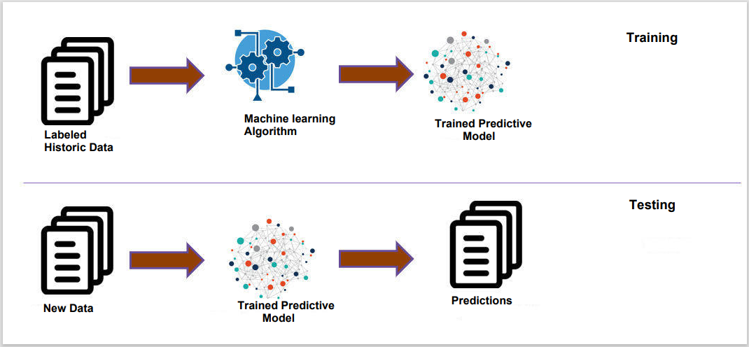
Supervised Learning
Supervised learning is learning with labels.
Supervised Learning

Slide 8
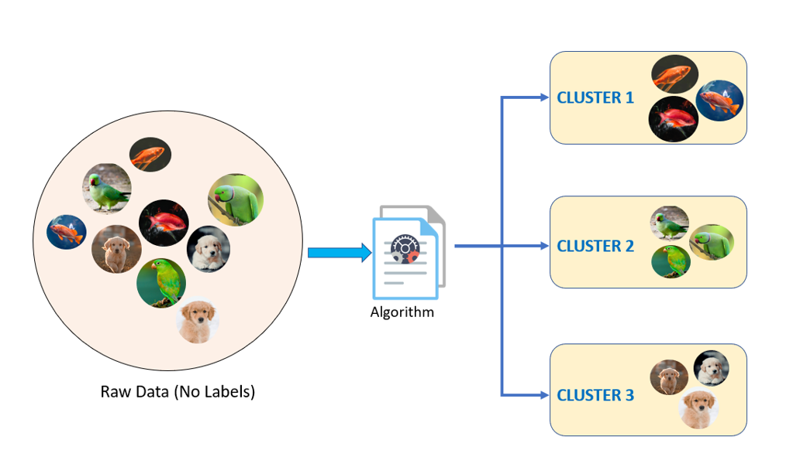
Unsupervised Learning
Un-supervised learning is learning without labels.
Unsupervised Learning

Slide 9
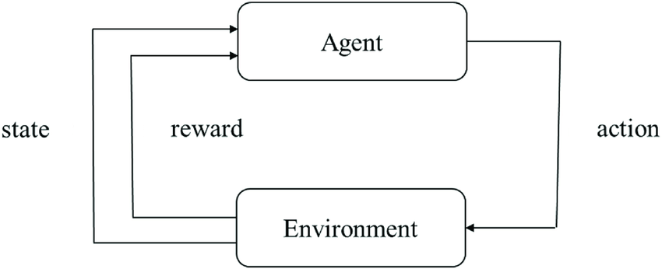
Reinforcement Learning
Reinforcement Learning is objective based learning.
Algorithm improves by learning from its mistakes(feedback).
Reinforcement Leaning

Slide 10
Limitations
Supervised Learning | Unsupervised Learning | Reinforcement Learning
Time consuming to train algorithm | It can’t give precise information regarding data sorting | It requires plenty of data and involves a lot of computation
It requires expertise to label data | It gives wildly inaccurate results unless we have human intervention to validate the output variables | Too much of reinforcement may cause an overload which could weaken the results.
Unwanted data degrades efficiency |  | High maintenance cost.

Slide 11
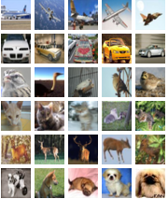

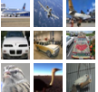
Self Supervised Learning
CNN Model
Representation
Pretext
Unlabeled Dataset
Representation
Classifier
Downstream
Fine tune Dataset
CNN Model
Multi label Classification
Self Supervised Learning

Slide 12
Why move towards Self-Supervised learning
Self-supervised learning creates a data-efficient AI system that can analyze and process data without human intervention , eliminating the need for full
“ Supervision”
Self-supervised learning eliminates the necessity of data labeling. It enables computers to label, categorize, and analyze data themselves

Slide 13
Literature Review

Slide 14
Literature Review
Self-supervised learning is performed in two steps.
Pretext Task
Downstream Task

Slide 15
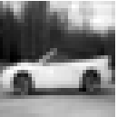
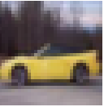
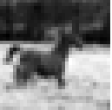
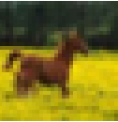
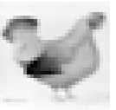
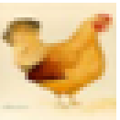
Self-Supervised Learning
Self-supervised learning is a machine learning process where the model trains itself to learn one part of the input from another part of the input
Comprises of two main stages:
Pre-Text
Downstream
Preprocessing
CNN
Model
weights
Pretext
Input Images
Output Images
Image Preprocessing
Classification Model
CNN
Downstream
Dataset
Self-Supervised Learning
Multi label Classification

Slide 16
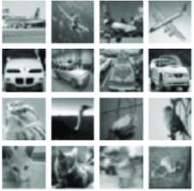
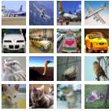
Pre-Text Task
The Pretext task enables the model to know the data features and generates targets.
Pre-Processing
CNN
Model
Pretext Task
Input Image
Output Image
Pre-Text Task of Self Supervised Learning

Slide 17
Downstream Task
The real (downstream) task can be anything like classification or detection tasks with insufficient annotated data samples.
In this case, it fine-tunes the learning model from the pre-text for data classification.
Pre-Text Task
Classifier
Weights
Downstream
Multi label Classification
Fine tune Dataset
Downstream Task of Self-Supervised Learning

Slide 18
Paper | Conference | Datasets | Year | Results
Unsupervised Representational Learning by Predicting Image Rotations | ICLR | CIFAR-10 ImageNet Places-205 | 2018 | Conv5:36.5
Colorful Image Colorization | un publish | ImageNet eTRIMS Image Database | 2016 | Conv5:32.3
Unsupervised Visual Representational Learning by Solving Jigsaw Puzzles | ECCV | ImageNet2012 PASCAL VOC 2007 | 2016 | Conv5:34.6
Context Encoders: Feature Learning by In-painting | CVPR | ImageNet | 2016 | PSNR:18.58dB

Slide 19
Paper | Conference | Dataset | Year | Results
Unsupervised Visual Representation Learning by Context Prediction | ICCV | ImageNet | 2015 | Conv5:57.8
Unsupervised Learning by Cross-Channel Prediction | CVPR | Places205 | 2017 | Conv5:38.1
Photo-Realistic Single Image Super-Resolution Using a Generative Adversarial Network | CVPR | FFHQ BSD VGGFace2 SET14 PRIM | 2016 | MOS:29.40
Deep Clustering for Unsupervised Learning of Visual Features | ECCV | CIFAR10 ImageNet CIFAR100 Places205 | 2018 | Conv5:36.1

Slide 20
Paper | Conference | Dataset | Year | Results
GAN-Based Image Colorization for Self-Supervised Visual Feature Learning | MDPI Sensors | Pascal VOC COCO | 2022 | PSNR SSIM

Slide 21
Research Gap
In previous work the focus has been on pre-text task and downstream task of self supervised learning
There is no comparison between supervised learning and self-supervised learning

Slide 22
Problem Statement
To apply multiple self-supervised learning frameworks on specific datasets to establish improved learning capacity of self-supervised algorithm in comparison with supervised learning algorithm

Slide 23
Research Goals
To implement the following tasks for the evaluation of Pretext Task
Image Colorization
Image Rotation
Jigsaw Puzzles Solving
To evaluate their results on different state-of-art evaluation metrics
To compare their results

Slide 24
Methodology

Slide 25



Image Colorization
CGANs
Image-Preprocessing
Generator(U-Net Model)
Encoder (Down sample) | Decoder (Up sample)
$$L^{^}$$
Input Image
$$A^{^}$$
$$B^{^}$$
Pretext
LAB
Color Space
L
A
Discriminator
B
Original Image
Weights
Aero plane
Image Preprocessing
CNN Classifier
Automobile
Downstream
Colored Dataset
Bird
Proposed Methodology for Image Colorization by SSL
Multi Label Classification

Slide 26
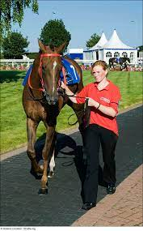
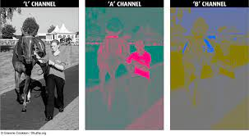
RGB to LAB
RGB Image
LAB
R=Red
G=Green
B=Blue
L=Gray scale Channel
A= Green to Red
B=Blue to yellow

Slide 27
CGAN
Greyscale
U-NET Generator
Predicted Images
GAN Discriminator
Real/Fake
Original

Slide 28
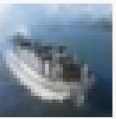
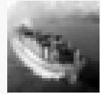
CGAN Generator (U-Net Model)
Decoder
(Up sample)
Encoder
(Down Sample)
Condensed Bottleneck Layer
1*1*256
Output Image
(Predicted)
Input Image
(Gray scale)
32*32*2
16*16*64
8*8*128
4*4*256
2*2*512
32*32*1
16*16*32
8*8*64
4*4*128
2*2*256
U-Net Model Generator

Slide 29
Generator U-Net Model
32
32
32*32*64
32
32*32*2
32*32*32
32*32*1
32*32*2
64
64
16*16*128
64
16*16*64
16*16*64
16*16*32
128
128
8*8*256
128
8*8*128
8*8*128
8*8*64
4*4*512
256
256
256
4*4*256
4*4*256
Padding=Same
Convolution 3*3
Down sample 2*2
Stride=2
Up-Con 2*2
Final Conv 2*2
4*4*128
256
256
2*2*512
256
2*2*256
2*2*256
2*2*256
1*1*256

Slide 30
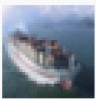
CGAN Discriminator Model
GAN Discriminator
Predicted
Image
Real/Fake
Original Image

Slide 31

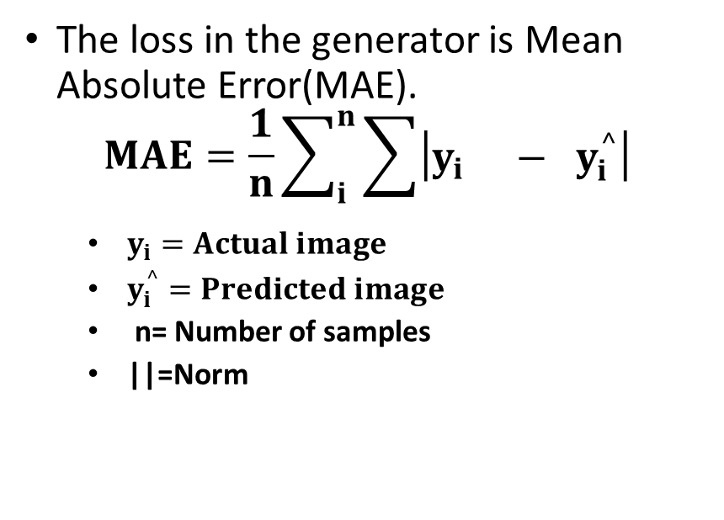

Loss Functions
Generator Loss Function
Discriminator Loss Function
The loss in the generator is Mean Absolute Error(MAE).
$$MAE=\frac{1}{n}\sum_{i}^{n}{\sum{\left|\begin{matrix}y_{i} & −{ y}_{i}^{^}\end{matrix}\right|}}$$
$y_{i}=Actual image$
$y_{i}^{^}=Predicted image$
n= Number of samples
||=Norm
The loss in discriminator is Binary Cross Entropy loss(BCE).
$BCE=\frac{1}{N}\sum_{i=1}^{N}{−(y_{i}∗log\left(p_{i}\right)+\left(1−y_{i}\right)∗log(1−p_{i}))}$
$y_{i}=Actual ouutput\left[0,1\right]$
$p_{i}=predicted value$
N=number of samples

Slide 32


Evaluation Metrics
The metrics are used for the evaluation of CGANs output are following:
Peak Signal to Noise Ratio:
$$PSNR=10\log_{10}\left(\frac{\left(2^{n}−1\right)}{MSE}\right)$$
Mean Square Error(MSE)
$$MSE=\frac{1}{H∗W}\sum_{i=1}^{H}{\sum_{j=1}^{W}{[X\left(i,j\right)−Y(i,j)]}}$$
Structure Similarity Index Measure(SSIM)
$$SSIM=\frac{(2μ_{x}μ_{y+}C_{1})(2δ_{x}δ_{y}+C_{2})}{(μ_{x}^{2}+μ_{y}^{2}+C_{1})(δ_{x}^{2}+δ_{y}^{2}+C_{2})}$$
n= number of bits
H=height of image
W=width of image
i,j=Pixel Coordinates of original &
Predicted Images
$μ_{x=Mean of actual Image}$
$μ_{y=Mean of Predicted Image}$
$δ_{x=Variance of actual image}$
$δ_{y=Variance of predicted image}$
$δ_{\begin{aligned}xy=Covariance of actual & predicted \\ image\end{aligned}}$
$C_{1}C_{2}C_{3}$=Constants

Slide 33
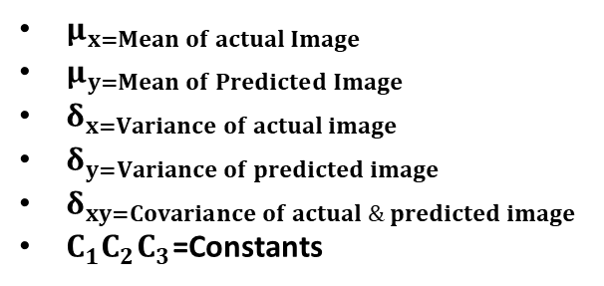
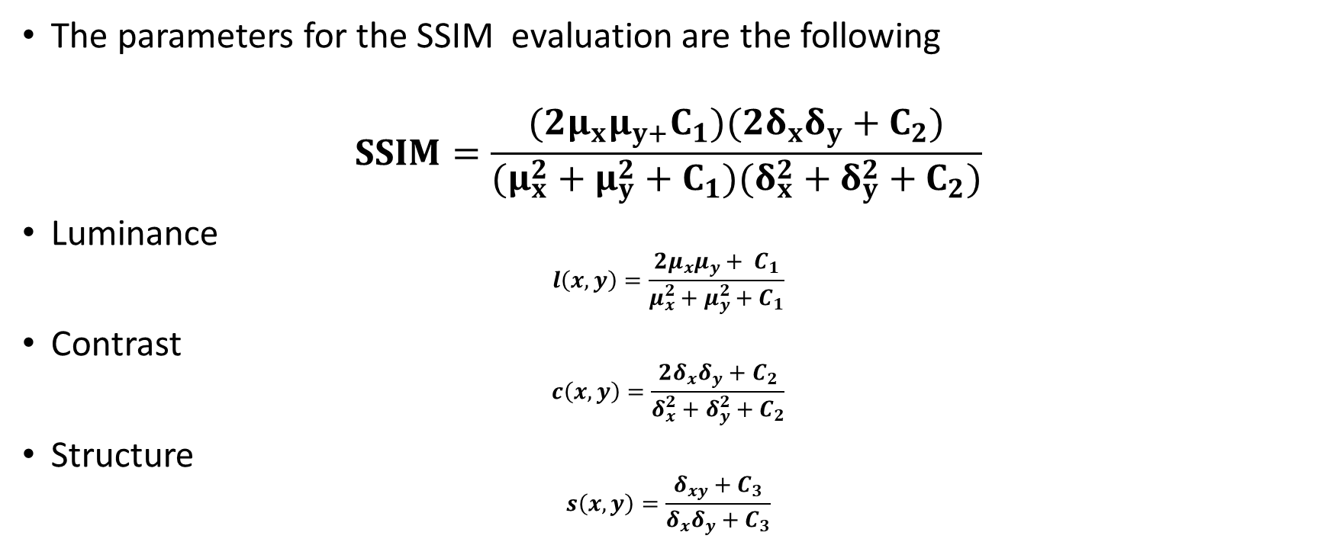
Structure Similarity Index Measure(SSIM)
The parameters for the SSIM evaluation are the following
$$SSIM=\frac{(2μ_{x}μ_{y+}C_{1})(2δ_{x}δ_{y}+C_{2})}{(μ_{x}^{2}+μ_{y}^{2}+C_{1})(δ_{x}^{2}+δ_{y}^{2}+C_{2})}$$
Luminance
$$l\left(x,y\right)=\frac{2μ_{x}μ_{y}+ C_{1}}{μ_{x}^{2}+μ_{y}^{2}+C_{1}}$$
Contrast
$$c\left(x,y\right)=\frac{2δ_{x}δ_{y}+C_{2}}{δ_{x}^{2}+δ_{y}^{2}+C_{2}}$$
Structure
$$s\left(x,y\right)=\frac{δ_{xy}+C_{3}}{δ_{x}δ_{y}+C_{3}}$$
$μ_{x=Mean of actual Image}$
$μ_{y=Mean of Predicted Image}$
$δ_{x=Variance of actual image}$
$δ_{y=Variance of predicted image}$
$δ_{xy=Covariance of actual \& predicted image}$
$C_{1}C_{2}C_{3}$=Constants

Slide 34
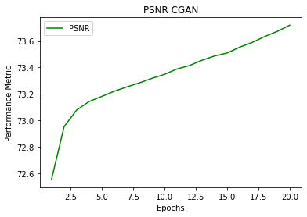
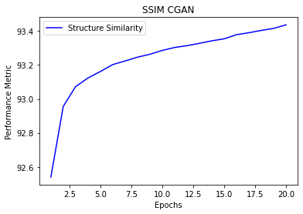
Results OF SSL

Slide 35
Discriminator Model
32*32*3
32*32*32
32*32*3
16*16*32
16*16*64
Input Image
Conv 1
Conv 2
Average Pooling
Conv 3
Conv 4
Dense 1
Dense
Flatten
Average Pooling
Conv 5
Conv 5
Output
8*8*64
16*16*64
4096

Slide 36
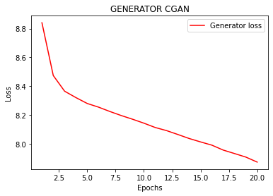
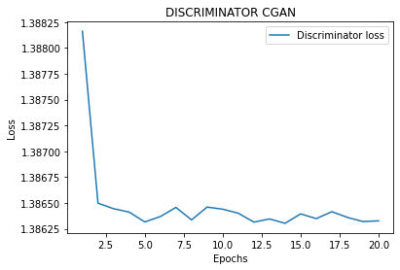
Results of SSL

Slide 37

Downstream Task:
32*32*32
Take encoder part of the generator
One Hot encoding labeling is used
Flatten the last concatenate layer
Two dense layers
Output layer is sigmoid layer
64
64
16*16*64
128
128
8*8*128
8*8*64
Flatten Layer
256
256
Dense Layer
4*4*256
output
4*4*128
256
256
2*2*512
0-9
2*2*256
2*2*256
Multi label Classification
2*2*256
1024
1024
1*1*256
2048

Slide 38
Downstream Task:
Flatten Layer
Conv1
Conv2
Conv3
Conv4
Bottle neck
Conv5
Output Layer
Dense Layer
Dense Layer

Slide 39
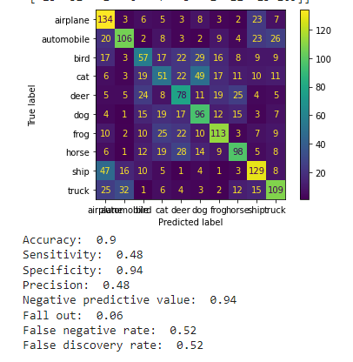
Evaluation of Downstream Task:

Slide 40
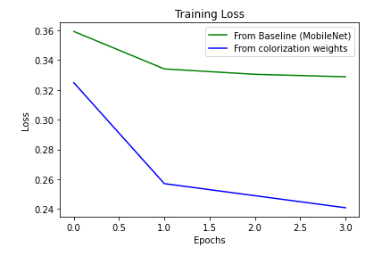
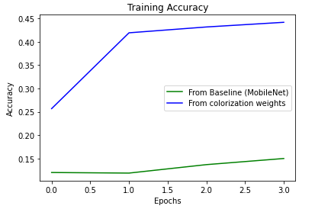
Comparison Graph

Slide 41
Mobile Net Model:
Mobile Net model is used for Supervised Learning model.
The parameters are same as in colorized model
Convert the Testing dataset into LAB color space

Slide 42
Mobile Net Model
FC
Data
Processing
Dataset
16*16*32
Point wise
convolution
Depth wise convolution
Depth wise Convolution=13 Layers (3X3)
Point wise Convolution=13 layers (1X1)
Fully Connected Fc= 1024
Dense Layers=1024
Output Layer= 0-9
(0-9)
Multi label Classification
Dense Layers

Slide 43
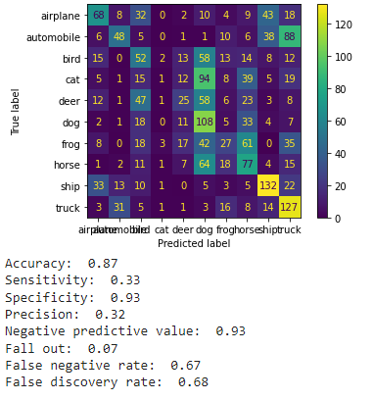
Results of Mobile Net

Slide 44

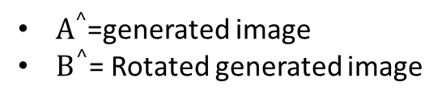


Image Rotation
Model
Latent Dimension
4096
Generator
Random Noise
Pretext
Dataset
$$A^{^}$$
$$B^{^}$$
Dataset
Normalization+Rotation label
Discriminator
$A^{^}$=generated image
$B^{^}$= Rotated generated image
Rotated Dataset
Weights
Data Processing
CNN Classifier Model
(0,9)
Fine tune Dataset
Multi label Classification

Slide 45
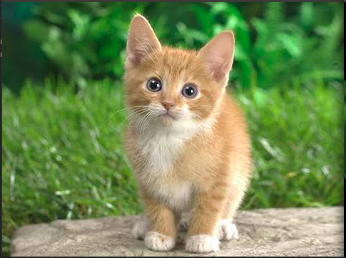
Data Processing
 | 0 Degree | 90 Degree
 | 180 Degree | 270 Degree

Slide 46
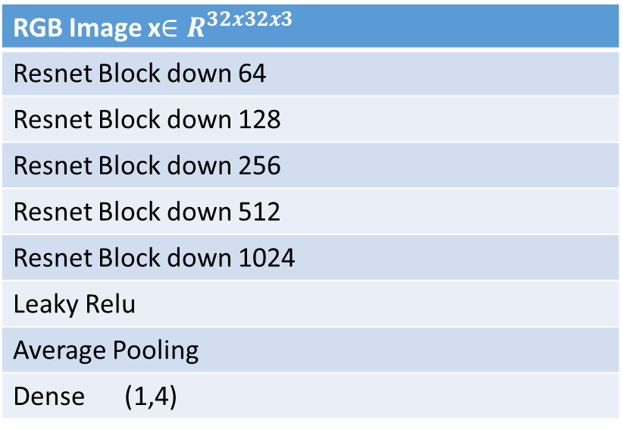
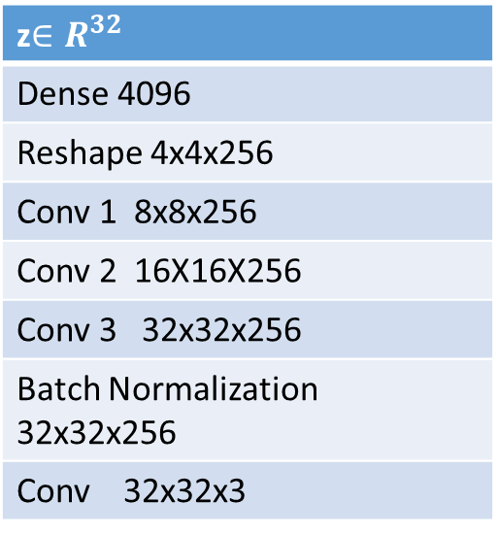
Generator & Discriminator Model
z$∈R^{32}$
Dense 4096
Reshape 4x4x256
Conv 1 8x8x256
Conv 2 16X16X256
Conv 3 32x32x256
Batch Normalization 32x32x256
Conv 32x32x3
RGB Image x$∈R^{32x32x3}$
Resnet Block down 64
Resnet Block down 128
Resnet Block down 256
Resnet Block down 512
Resnet Block down 1024
Leaky Relu
Average Pooling
Dense (1,4)

Slide 47
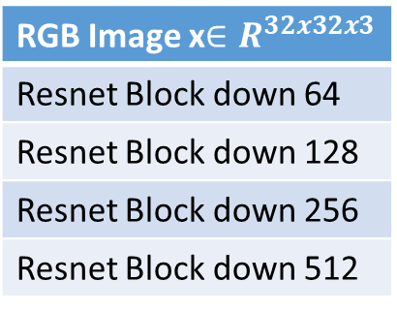
Downstream of Image Rotation
FC
RGB Image x$∈R^{32x32x3}$
Resnet Block down 64
Resnet Block down 128
Resnet Block down 256
Resnet Block down 512
Pre-trained model
Pre Trained Weights of Image Rotation
Fine Tune Dataset
Output Layer
(0-9)
Multi label Classification
Dense Layer

Slide 48
Loss Function
The loss function of the image rotation are
Categorical Cross Entropy Loss
Hinge Loss

Slide 49
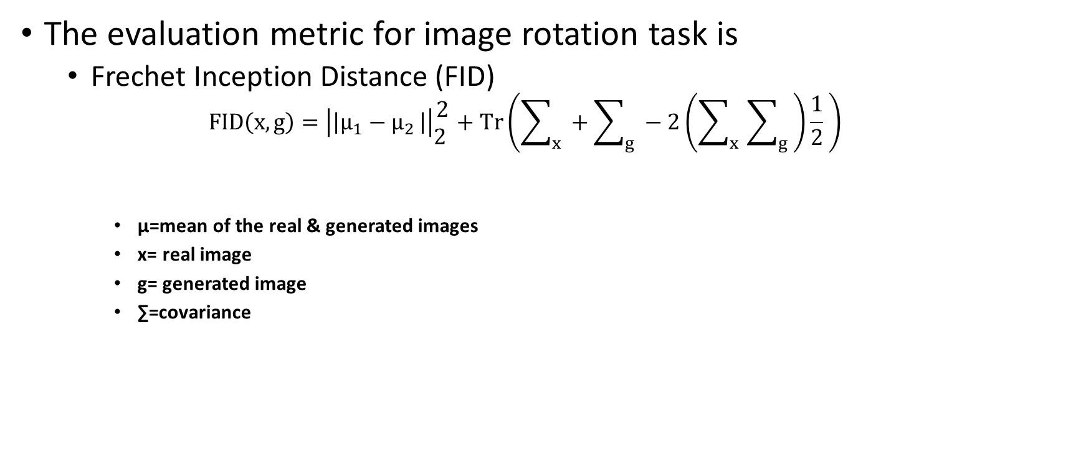
Evaluation Metric
The evaluation metric for image rotation task is
Frechet Inception Distance (FID)
$$FID\left(x,g\right)=\left|\left|μ_{1}−μ_{2 }\right|\right|\begin{matrix}2 \\ 2 \end{matrix}+Tr\left(\sum_{x}{ }+\sum_{g}{ }−2\left(\sum_{x}{ }\sum_{g}{ }\right)\frac{1}{2} \right)$$
μ=mean of the real & generated images
x= real image
g= generated image
∑=covariance

Slide 50
Jigsaw Puzzles Solving
Data Processing
Auto encoders
Encoders | Decoders
9x10x10x3
Pretext
32x32x3
Weights
Data Processing
CNN Classifier
Downstream
Multi label Classification

Slide 51
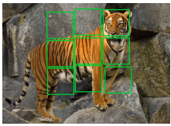
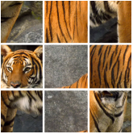
Data Processing
Input Image
Output Image
Image Size=32x32x3
Total Tiles=9
Tile size=10x10X3

Slide 52
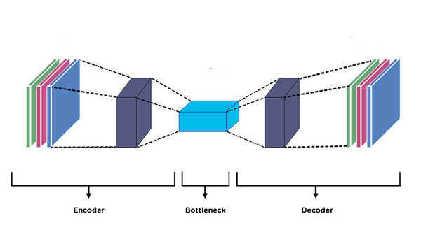
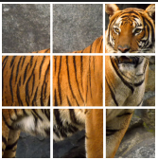
Auto Encoders
Output Image
Input image

Slide 53
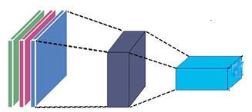
Downstream of Jigsaw Puzzle
FC
Data Processing
Fine tune Dataset
(0-9)
Multi label Classification
Output Layer
Dense Layer

Slide 54
Loss Functions
The loss function for the task are following
Mean Square Error
Mean Absolute Error

Slide 55
Experiments & Results

Slide 56
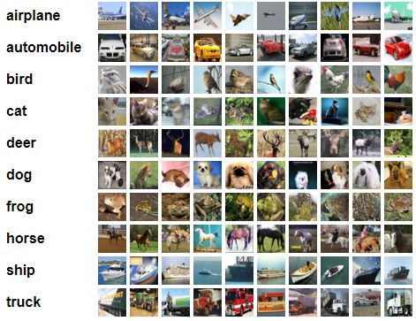
Dataset
CIFAR-10 Dataset
Image size is 32*32*3
It has 10 classes
It has 60000 images
The 50000 images are training images
The 10000 images are testing images

Slide 57
Quantitative Results
Metric | Average | Min | Max
PSNR | 74.85 | 53.63 | 99.84
SSIM | 93.74 | 16.04 | 99.95
Results of PSNR & SSIM in Training Images
Metric | Average | Min | Max
PSNR | 72.58 | 56.08 | 95.28
SSIM | 92.58 | 41.59 | 99.91
Results of PSNR & SSIM in Testing Images

Slide 58
Quantitative Results
Model Initialization | Classification Improvement (Accuracy)
Baseline | 25.43%
Colorization Pre-Training | 35.47%

Slide 59
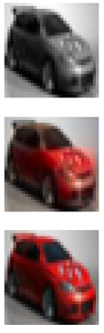
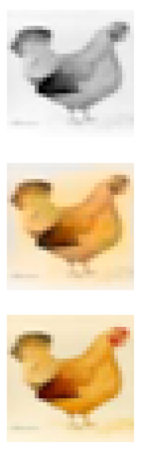
Qualitative Results:
Parameters | Results
Input Image
Generated
Ground Truth

Slide 60
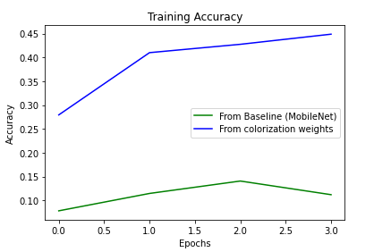
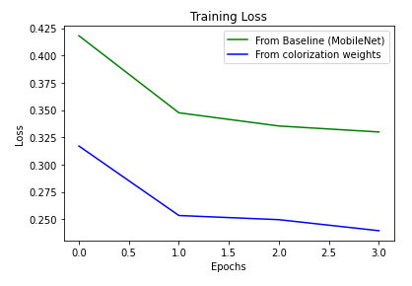
Comparison Graphs of Image Colorization

Slide 61
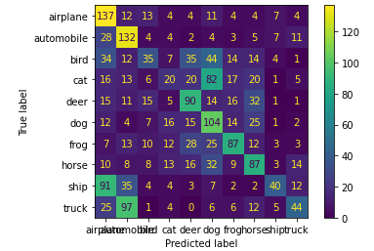





Downstream Task of Image Colorization:
Downstream task is evaluated on confusion matrix
Parameters for evaluation of Confusion matrix
$Accuracy=\frac{(TP+TN)}{(TP+FP+FN+FP)}$
$Precision=\frac{(TP)}{(TP+FP)}$
$Recall/Senstivity=\frac{(TP)}{(TP+FN)}$
$True Negative Rate/Specificity=\frac{(TN)}{(TN+FP)}$

Slide 62


Baseline Evaluation of Image Colorization
Mobile Net model is evaluated on confusion matrix
Parameters for evaluation of Confusion matrix
$Accuracy=\frac{(TP+TN)}{(TP+FP+FN+FP)}$
$Precision=\frac{(TP)}{(TP+FP)}$
$Recall/Senstivity=\frac{(TP)}{(TP+FN)}$
$True Negative Rate/Specificity=\frac{(TN)}{(TN+FP)}$

Slide 63


Image Rotation Loss Function

Slide 64

Evaluation Metric Graph

Slide 65


Confusion Matrix
Baseline Model
Image Rotation Pre-Train
The evaluation metric for Self Supervised Learning & Supervised Learning

Slide 66


Comparison Base line vs Proposed

Slide 67

Loss Function of Jigsaw Puzzle

Slide 68


Evaluation Matrix for Jigsaw Puzzles
Baseline Model
Jigsaw Puzzles Pre-Train
The evaluation metric for Self Supervised Learning & Supervised Learning

Slide 69


Comparison Graphs Baseline vs Proposed

Slide 70

Comparison Graph for all Methodologies
Evaluation Scores between Baseline vs Proposed

Slide 71
Conclusion
Research on image colorization and rotation using GANs has shown promising results in enhancing and manipulating images.
GANs allow for the generation of high-quality, realistic images with improved colorization and rotation compared to traditional methods.
The proposed architecture are nor well perform on jigsaw puzzles.
The future work could include incorporating additional image manipulation techniques, such as image super-resolution or de-noising, into the GAN framework.
The architecture of auto encoders for jigsaw puzzles could be improved.

Slide 72
Thank You

Slide 73
Questions & Answers

